Slide 1
Focus40
Focus40 Draft Plan Preview
Fiscal and Management Control Board
June 18, 2018

Slide 2
Purpose & Agenda
Purpose: To preview Focus40 programs in advance of release of the draft Focus40 Plan.
Agenda:
Focus40 Process Review
Focus40 Proposed Programs
Plan Elements and Next Steps

Slide 3
Focus40 Overview
A long-range plan for how the MBTA can meet the needs of the region in 2040:
A 20-year plan as required by MBTA enabling legislation
A roadmap of investments to feed future MBTA Capital Investment Plans
Key Components of Focus40 Plan:
Programs: Highlight potential investments that could enable the MBTA system to best serve the region over the long term, divided into three categories (We’re Doing, We’re Planning, We're Imagining)
Priority Places: Identify priority areas for new or improved service based on where investments have the greatest likelihood to deliver ridership and other benefits to the region
Focus40 is NOT a Financially-Constrained Capital Plan
Once finalized, investments not yet underway (those identified in We’re Planning: Priorities through 2040) will be prioritized for planning/design work and, if deemed to be cost-effective, phased through existing, rolling 5-year capital planning process

Slide 4
Advancing the Goals of the Strategic Plan
SAFETY
CUSTOMERS
INFRASTRUCTURE
FISCAL SUSTAINABILITY
ACCESSIBILITY
WORKFORCE
MANAGEMENT
ENVIRONMENT
GOVERNANCE
CAPACITY

Slide 5
Connecting Supporting Plans
Systemwide Plans
Plan for Accessible Transit Infrastructure
Fleet & Facilities Plan
Focus40
Water Transportation Study
Better Bus Project
Commuter Rail Vision
Mattapan High Speed Line
Green Line Capacity
Modal and Project Plans

Slide 6
Related Planning Processes
MBTA Strategic Plan
Capital Investment Plan (CIP)
Implementation
Focus40

Slide 7
Focus40 Process

Slide 8
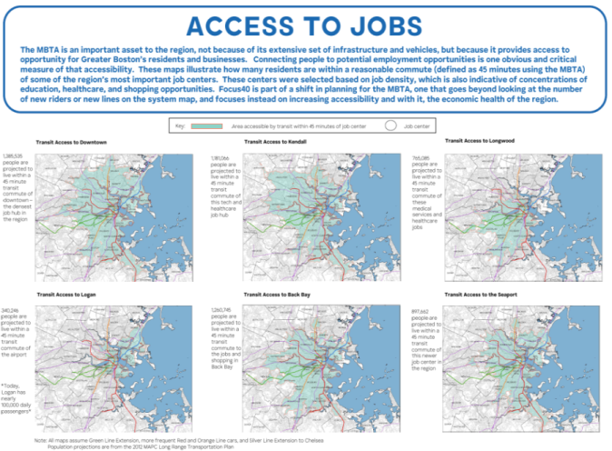
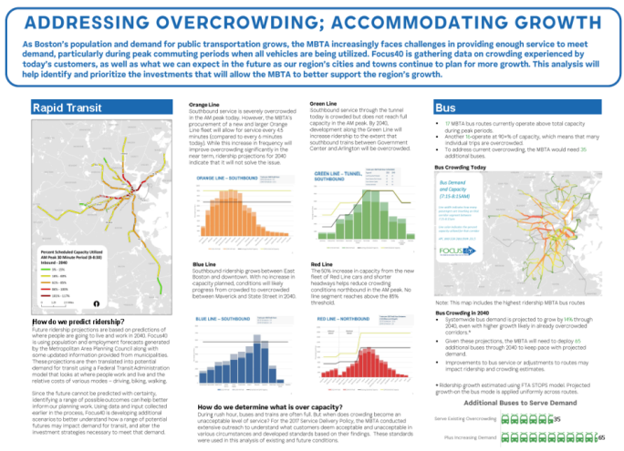
Data Collection
Existing and Future Conditions
Trends

Slide 9
Engagement

Slide 10
Goals
Equity & Affordable Housing
Improving mobility options for all – regardless of income or ability - & supporting more affordable housing near high quality transit
Sustainability
Contributing to achieving Greenhouse Gas reduction goals
Livability
Improving quality of life with more customer-focused transit options
Economic Competitiveness and Prosperity
Supporting local and regional economic growth and competitiveness
Focus40: Positioning the MBTA to meet the needs of the region in 2040
Climate change and the adverse weather conditions it will bring make it even more important that the region’s transit system is built and retrofitted for resilience
To Serve the Needs of the Region the MBTA must be:
Reliable
Robust
Resilient
Providing service that is safe, reliable, on-time, and high quality for customers of all ages and abilities
Providing service that has the capacity to take people where they want to go as demand for transit increases
Providing service that is built to last through extreme weather and other disruptions

Slide 11
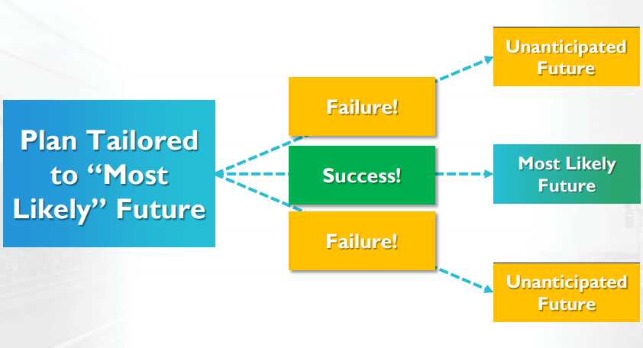
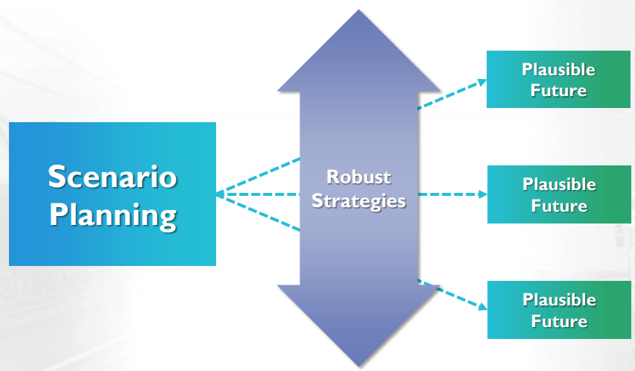
Scenario Planning
Focus40 uses scenario planning to better understand what the MBTA’s region might be like in 2040.
Instead of planning for one specific future, Focus40 developed four plausible futures for the region.

Slide 12
Focus40 Scenarios
DRIVING TRENDS
PLAUSIBLE FUTURES
Urbanization
Affordability
Technology
Climate Action
Suburbanization
Low Affordability Near Transit
Low Collective Action
Gradual Evolution
MetroFuture
Boston MPO vision for compact, sustainable growth.
High Affordability Near Transit
Urbanization
Disruptive Change
High Collective Action
Suburbanization
Low Affordability Near Transit
Gradual Evolution
Low Collective Action
Business as Usual
Low and moderate income households are choosing to live in more affordable suburbs & Gateway Cities
Urbanization
High Affordability Near Transit
Disruptive Change
High Collective Action
Innovation Acceleration
Suburbanization
Low Affordability Near Transit
Gradual Evolution
Low Collective Action
Technology changes are adopted quickly and radically change the transportation landscape
Urbanization
High Affordability Near Transit
Disruptive Change
High Collective Action
Climate Responsive
Suburbanization
Low Affordability Near Transit
Gradual Evolution
Low Collective Action
Enhanced commitment by the Commonwealth to invest in GhG reduction and resiliency measures
Urbanization
High Affordability Near Transit
Disruptive Change
High Collective Action

Slide 13
Scenario Planning Investment Framework
Focus40 uses a conceptual scenario planning framework to help prioritize potential programs. In the draft plan, those investments categorized as “We’re Planning” are considered to work in all or most plausible futures. Those programs categorized as “We're Imagining” work in some futures, but are under consideration as hedging and/or shaping strategies.
Investment classification | Lower risk | Higher risk
Investment is important in all/most futures | We’re Doing: Commitments Underway (current or near-term need)
 | We’re Planning: Next Priorities (needed in all/most futures)
Investment could be important in some futures | Deferred, while tracking drivers of future needs | We're Imagining: Big Idea - Hedging (might not be necessary given future context)
 |  | We're Imagining: Big Idea - Shaping (may influence the future context)
Investment is not important in any future | Not included

Slide 14
Focus40 Places

Slide 15
Priority Places Overview
Focus40 is trying to shift the conversation…
Instead of starting with expansion project ideas, Focus40 is about identifying places that need and can support higher quality transit – Priority Places – and then developing projects to serve those places.
Focus40 identifies Priority Places for new or improved service based on where investments have the greatest likelihood to deliver ridership and other real benefits to the region, where:
Improved service could address a clear transportation need and help support broader goals for the region
Many elements indicate that the place can support higher quality transit
There is a demonstrated transportation need today that is likely to grow
Three types of priority places:
Major Employment / Destination Districts
Inner Core Communities Lacking Rapid Transit
Urban Gateways

Slide 16
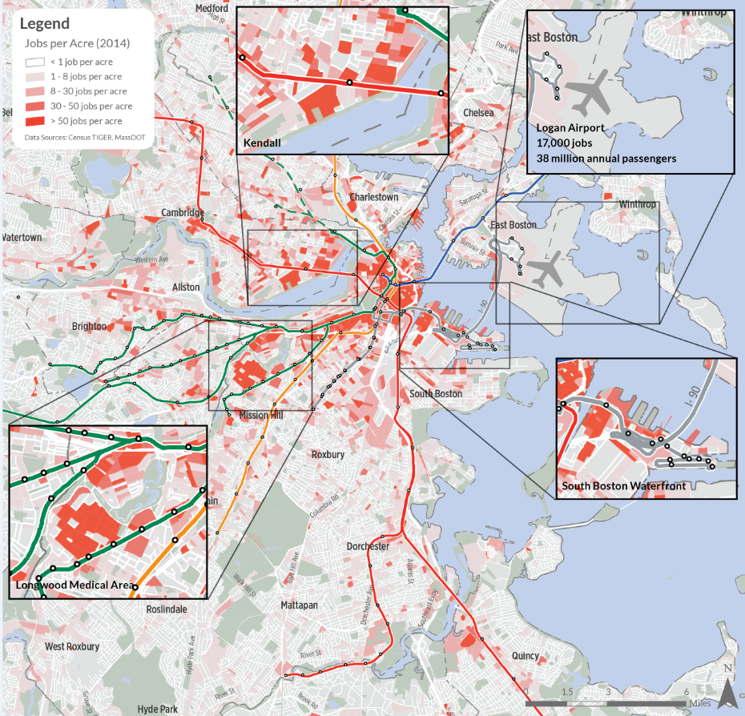
Major Employment/Destination Centers
Characteristics:
Growing business districts just beyond the densest part of the rapid transit network
Longer than average transit commute times, often requiring one or more transfers
The overloading of existing road networks and MBTA services
The presence of multiple shuttle providers to compensate for insufficient MBTA service
Examples:
South Boston Waterfront
Kendall Square
Longwood Medical Area
Logan Airport

Slide 17
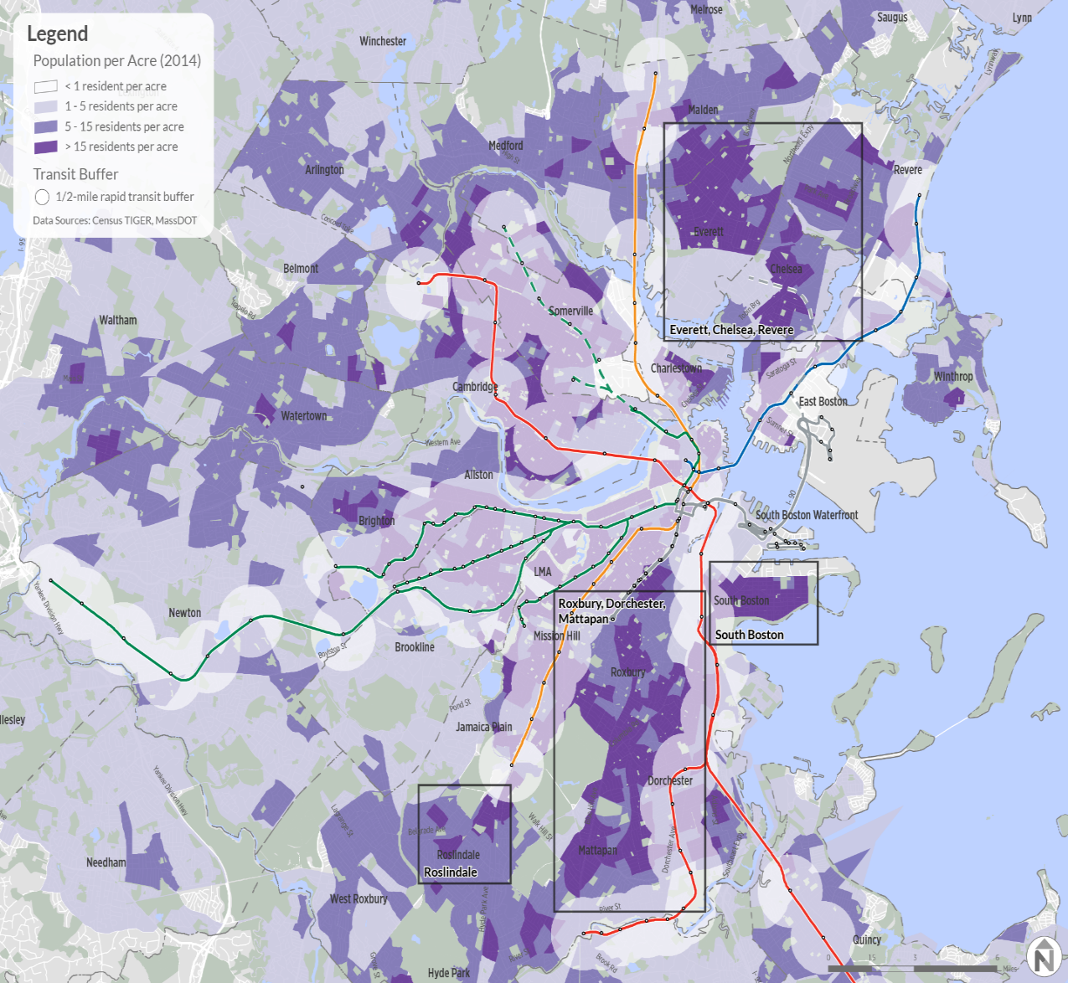
Inner Core Communities Lacking Rapid Transit
Characteristics:
Residential areas between the rapid transit network that are only served by bus or commuter rail
Commuter rail access that does not fully serve the needs of the community given how our commuter rail system currently works at the inner ends of the system
Many are lower-income communities and/or transit dependent
Examples:
Chelsea
Everett
Blue Hill Avenue (Boston)
Roslindale (Boston)

Slide 18
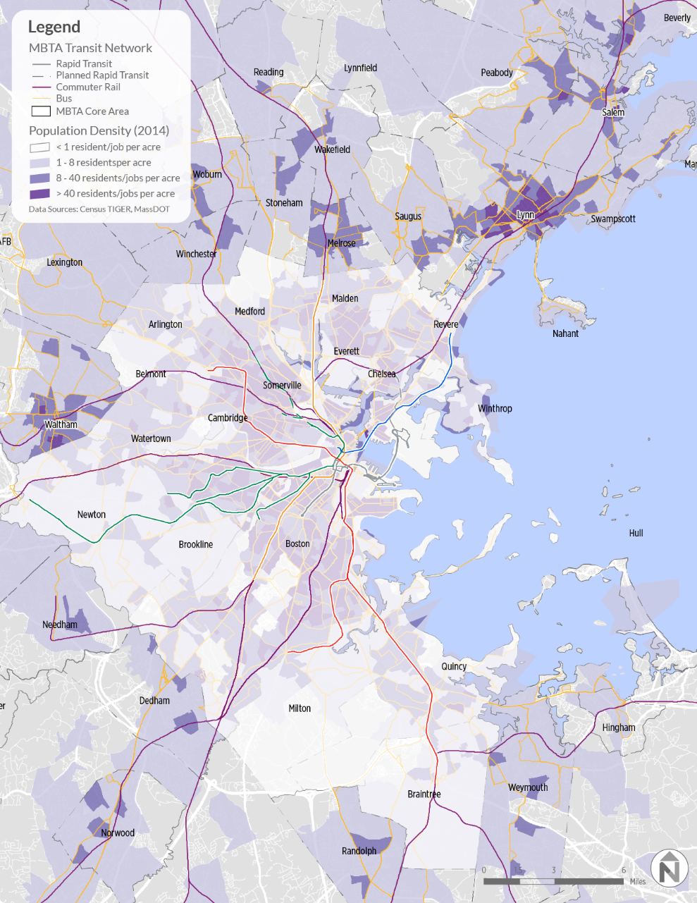
Urban Gateways
Characteristics:
Located beyond the rapid transit network and served by commuter rail that often functions as a hub for local MBTA or regional transit authority bus service
A large population of low-income residents and/or transit dependent residents
A moderate-intensity balance of residential and commercial development either built or permitted
Examples:
Lynn
Salem
Waltham

Slide 19
From Priority Places to Programs to Projects
Focus40 is built on programs, each with a stated objective, following the pattern set by the Capital Investment Plan and Strategic Plan processes.
Eight are specific to existing MBTA modes/services and focused on making the existing system more reliable, robust and resilient
Three are systemwide (customer experience, resiliency, accessibility/paratransit)
An additional program is include for already planned and future expansions serving Priority Places.
Transit Action Plan conducted for Priority Place
Early action pilots and potential projects identified
Potential projects analyzed and designed
Project scored and prioritized as part of CIP process

Slide 20
Focus40 Programs

Slide 21
Proposed Programs Framework
Focus40 lays out studies, projects and investments within each program, divided into the following categories:
We’re Doing (Commitments through 2023): Investments that are programmed in the Capital Investment Plan.
We’re Planning (Next Priorities through 2040): Investment options that are important to meet the needs of the region in 2040 in most/all of the plausible future scenarios.
Will be prioritized for planning/design work and, if deemed to be cost-effective, phased through existing, rolling 5-year capital planning process.
We're Imagining (Big Ideas): Investment options whose feasibility, benefits, and costs must be better understood. Many of these big ideas are potentially transformative and may be important hedges or shaping investments for the region, depending on which future we expect or want.

Slide 22
Proposed Programs

Slide 23
Proposed Programs

Slide 24
Program Objective: Ensure that the vast majority of customers can use the MBTA’s increasingly accessible fixed-route system, while those who still need The RIDE have more and better service options.
We’re Doing: Commitments through 2023
RIDE Vehicle Replacement Program
Replacing 84.5% of The RIDE’s fleet by mid-2022 with new, lower-emissions vehicles
Dispatch Process Redesign to Provide RIDE Customers with Additional Options
Offer customers Lyft, Uber, and taxi options
Plan for Accessible Transit Infrastructure (PATI) Phase 1: Plan Completion and Early Actions
Priority Rail Station and Bus Accessibility Improvements
Wollaston, Red Line
Oak Grove, Orange Line
Hynes, Symphony, Green Line
BU West/St. Paul, Babcock/Pleasant Street, Green Line B branch
Newton Highlands, Green Line D branch
We're Planning: Next Priorities through 2040
Implementation of (PATI) Mid-Term Recommendations
Includes Green Line surface stop accessibility
RIDE Service Reimagining
Based on new data and technology and a more accessible fixed route system
We're Imagining: Ridership growth from development around bus and commuter rail stops that supports investment to make them fully accessible.

Slide 25
Program Objective: Provide regular and occasional riders alike with high quality services that are easy to navigate and pay for and a pleasure to use.
We’re Doing: Commitments through 2023
Automated Fare Collection (AFC 2.0)
All-new fare collection system to be completed by May 2020, with new fare gates Spring 2021
Single application on fare card, smartphone, or contactless credit card for boarding all modes of transit, including commuter rail
Reduces boarding time, speeds up service on Green Line and buses
Potential for seamless integration with Regional Transit Authorities, Lyft/Uber, and other micro-transit systems
Station Improvements
Signage, wayfinding, and lighting improvements systemwide
Digital MBTA
Real-time information for travel planning and performance enhancements
We're Planning: Next Priorities through 2040
Station Modernization, Including Exploration of Platform Barriers and Doors
Platform doors can speed boarding, improve safety, and reduce delays
Partnerships for Improved First-Mile/Last-Mile Connections
System Access Improvements (parking and other)
Where is more parking needed?
What are better uses for underutilized parking areas?
Where should increased bicycle parking be added?
Will drop-off access grow as a customer preference?
We're Imagining: A “Digital MBTA” that is at the cutting edge of using technology to enhance the transit experience and encourage transit use.

Slide 26
Program Objective: Retrofit priority T assets to withstand severe weather and sea-level rise and ensure all new construction meets strict resiliency standards.
We’re Doing: Commitments through 2023
System-Wide Climate Change Vulnerability Assessments
Blue Line Resiliency and Adaptation
Green Line Portal Protection
Adaptation Strategies for Priority Infrastructure in Collaboration with Municipalities
Partnering with MassDOT, MAPC, EEA and municipal partners on data collection, vulnerability assessment, and solution development
We're Planning: Next Priorities through 2040
Incremental Implementation of System-Wide Climate Change Vulnerability Assessments
Identify strategies to address vulnerabilities
Incorporate resiliency upgrades into ongoing work
Resilient Power Supply
Prevent potential disruptions to power supply for Rapid Transit
We're Imagining: An MBTA fully resilient in even the most dire climate scenarios and providing essential mobility for the Boston region amid severe weather and sea-level rise

Slide 27
Program Objective: Focus new services and expansion projects on providing high frequency, reliable service to better meet the needs of those who live and work in and travel to Priority Places that can support high quality transit service.
We’re Doing: Commitments through 2023
Transit Action Plans for Priority Places (Lynn, Allston, Everett, Seaport)
Green Line Extension to Somerville/Medford
South Coast Rail Phase 1
Service Pilots
We’re Planning: Next Priorities through 2040
Placed-based Service Expansions Based on Pilots and Action Plans
Bus Rapid Transit
Infill Stations
Better Bus Project Phase 3: Network Redesign Implementation
Early Actions from Commuter Rail Vision
Regional Multimodal West Station
South Coast Rail Phase 2
We're Imagining: Rail extensions and new bus rapid transit routes better connecting Priority Places.

Slide 28
Program Objective: Accommodate growth at Logan International Airport and development sites in East Boston and Revere and ensure resiliency to severe weather and sea-level rise.
We’re Doing: Commitments through 2023
Resiliency Phase 1: Planning and Early Actions
Reliability Centered Vehicle Maintenance Program
Infrastructure Improvements between Maverick and Aquarium
Power and ventilation upgrades
Track replacement
We’re Planning: Next Priorities through 2040
Potential Downtown Pedestrian Connection between the Red and Blue Lines
Stations are only 600 feet apart
Alternative to Red-Blue Connector at Charles/MGH
Relieves congestion on Green and Orange Lines for Red-Blue connections
Step towards a Downtown Crossing-Park Street-State “downtown superstation”
Blue Line Capacity and Reliability Improvements
Can add capacity with operational improvements and expanding train-sets
Signal system upgrades
Resiliency Phase 2: Further Implementation
Portal to protect Aquarium-Maverick tunnel
Orient Heights maintenance yard resiliency
We're Imagining: Connecting the Blue Line to the Red Line, and extending it beyond to Back Bay and Longwood, and also north to downtown Lynn, to support transformational development

Slide 29
Program Objective: Increase capacity with redesigned, larger vehicles and modernized infrastructure on the nation’s busiest light rail line by at least 50%.
We’re Doing: Commitments through 2023
Green Line Transformation Phase 1: SGR Projects
Track, signal and power upgrades to improve reliability
Planning for Phase 2
Green Line Extension
4.5-mile extension to College Avenue in Medford and Union Square in Somerville
Puts 80% of all Somerville residents within walking distance of rapid transit
Surface Green Line Stop Consolidation
4 stops on B branch
Exploring other opportunities
Surface Green Line Transit Signal Priority Infrastructure
For trains at B, C, and E line street crossings
$30m improvement plan for 60 grade crossings
Green Line Train Protection: Collision-avoidance automatic-braking systems
Accessibility Upgrades at Hynes, Symphony Stations
We’re Planning: Next Priorities through 2040
Green Line Transformation Phases 2 & 3
All-new “Type 10” longer cars
116 feet long, compared to 74 now
Fully accessible, low-floors throughout car
Five entry-exit doors per car
Requires upgraded maintenance facilities
15% more capacity by increasing peak weekday trains from 73 to 94
50% more capacity by adding 2-car trains to D and E branches
Explore Reservation and Right-of-Way Expansion for Surface Green Line
Dedicated Right of Way on E-branch
Prevent turning conflicts on B & C branch
We're Imagining: Extensions to Mystic Valley Parkway in Somerville/Medford, Hyde Square in Jamaica Plain. Park Street-Downtown Crossing “superstation.” Reconfiguring 27 B and C branch stops to allow trains of two Type 10 cars, doubling capacity.

Slide 30
Program Objective: Enable a modernized line with peak trains every 3 minutes to connect residents of transit-oriented housing to growing job centers - all connected to a reimagined Mattapan Line.
We’re Doing: Commitments through 2023
Fleet Replacement and Maintenance Facility Upgrades
Replacing all 218 Red Line cars
Capacity and Reliability Improvements:
Modernizing signals, traction power
Improving Alewife bottleneck
Peak service increased from every 4.5 minutes to 3 minutes
Red Line South Improvements (Wollaston, TOD, Parking Garages)
Mattapan High Speed Line Reimagining and Short-Term Improvements
Vehicles are over 70 years old and replacement parts and components are no longer available
Rehabilitate fleet to allow antique trolleys to continue operating until new technology becomes available
We’re Planning: Next Priorities through 2040
Downtown Pedestrian Connection between the Red and Blue Lines
Strategic Track Reconfiguration to Address Bottlenecks
Improve travel times and reduce delays by reconfiguring current track/signal bottlenecks at Park Street and Columbia Junction at JFK/UMass
Reimagine Mattapan Line
Based on reimagining study and outreach
We're Imagining: A connection to the Blue Line and a downtown superstation to improve the customer experience and reduce travel times.

Slide 31
Program Objective: Increase peak-hour service to every 4.5 minutes (3 minutes if development warrants) to serve homes and businesses throughout the growing corridor, serving additional riders from the Lower Mystic region.
We’re Doing: Commitments through 2023
Fleet Replacement and Maintenance Facility Upgrades
All 120 Orange Line cars are being replaced and 32 more are being added to expand the fleet
Roomier cars, larger doors for faster boarding
Wellington Car House to be rebuilt and expanded by 2021, with upgraded test track
Capacity and Reliability Improvements
Signal, power upgrades to support more frequent service
Peak service increased from every 6 minutes to 4.5 minutes
We’re Planning: Next Priorities through 2040
Orange Line Connectivity Improvements
Explore adding Commuter Rail station at Sullivan Square
Potential for future Silver Line-Orange Line connection if Silver Line is extended from Chelsea
Additional Capacity Improvements (3-Minute Headways)
Depending on pace of development evaluated by the Lower Mystic Regional Working Group
We're Imagining: Extensions to Roslindale and downtown Everett via spur from Sullivan Square to serve high travel demand. A North Station-Back Bay express shuttle to improve north-south commuter rail transfers. Buildout of a Sullivan Square Superstation, and Downtown Crossing/Park Street/State “downtown superstation.”

Slide 32
Program Objective: Add capacity and connectivity with an expanded and cleaner fleet that serves not only the Seaport, but an expanded Silver Line network extending beyond Chelsea.
We’re Doing: Commitments through 2023
Silver Line Fleet Planning and Procurement
Trial beginning late 2018 of vehicles that can operate in Transitway Tunnel
Silver Line Capacity Study
SL2 and SL4 On-Street Improvements
Erect barriers, partner with City of Boston to prioritize enforcement of designated bus lanes on Essex and Washington Streets
Transit Signal Priority Infrastructure in the Seaport
Reduce conflict, delays at D Street with buses emerging from Transitway tunnel
We’re Planning: Next Priorities through 2040
Silver Line Next Gen Fleet and Facility
Expanding fleet would improve rush-hour capacity and performance, will require an expanded Southampton Garage/other storage space
Silver Line Extension through Everett
For Revere, Malden, Everett, reduce crowding on bus routes and add near-rapid-transit service for residents beyond reach of Blue and Orange Lines
Infrastructure Upgrades in Tunnel
Fix leakage and drainage issues, roadway surface
We're Imagining: More exclusive right-of-way by eliminating the Transitway's at-grade crossing of D Street.

Slide 33
Program Objective: Achieve a better, faster, lower-emissions service, supported by off-board fare collection and exclusive busways, aligning with where riders live, work, and travel.
We’re Doing: Commitments through 2023
Better Bus Project Phase 1 to revamp routes, frequencies, and stops with implementation planned in 2019
Partnerships with cities and towns to implement bus lanes, traffic signal priority, “queue jumps” and other service enhancements
Better Bus Project Phase 2 to look at better ways to serve bus riders through a network redesign
Municipal collaboration to Improve High Priority Bus Facilities and Stops
Improved access and safety features at over 200 high-priority bus stops for accessibility improvements
Bus Fleet Replacement and Expansion
460 40-foot buses scheduled for delivery 2021-25
Option order procurement of 194 hybrid buses
Exploring new and expanded maintenance facilities
Zero- Emissions Bus In-Service Testing to inform future fleet procurement
We're Planning: Next Priorities through 2040
21st Century Vehicle Maintenance and Storage Facilities
Accommodate low/no emissions fleet
More resilient
More capacity for expanded fleet, more 60’ buses
Fleet Expansion to Serve Bus and Bus Rapid Transit Network
Better Bus Project Phase 3: Implementation of Network Redesign
Phased Conversion to Zero-Emissions Fleet
Pending findings from testing
New Bus Rapid Transit (BRT) corridors with more frequent, comfortable, accessible service and exclusive bus lanes
We're Imagining: Autonomous bus shuttles that can serve new routes and deliver first-mile/last-mile connections for passengers to commuter rail and rapid transit

Slide 34
COMMMUTER RAIL 2040
Program Objective: Serve more riders and non-commuting trips, by providing better connections to more destinations and potentially by implementing one or more new service models (urban rail/regional rail), pending results of Commuter Rail Vision Study.
We’re Doing: Commitments through 2023
Commuter Rail Vision
North Station Drawbridge
Faster and more reliable service out of North Station
South Coast Rail Phase 1
Bi-Level Coach Procurement and Locomotive Upgrades
Added capacity and more reliable vehicles
Ruggles Station Upgrades
More stops with better connections to Orange Line
Positive Train Control and Automatic Train Control
We're Planning: Next Priorities through 2040
Station Investments (Infill, Rapid Transit Connections)
Infill targeted for Priority Places
Regional Multimodal West Station and Midday Layover
Double and Triple Tracking to Add Capacity
Worcester Line and other congested areas
South Coast Rail Phase 2
We're Imagining: Electrification of some or all of the rail network with major capital projects supporting a system that is more than “commuter” rail

Slide 35
Program Objective: Support a robust, multi-operator Boston Harbor water transportation system, serving more passengers and destinations with excellent connections to landside T service.
We’re Doing: Commitments through 2023
Landside Infrastructure Improvements
Awarded FTA grant to upgrade Hingham dock, ramps, and floats
Accommodate persons with disabilities at all tide levels
Ease boarding and disembarking for all passengers
Fleet Expansion to Four Ferries
Two new T-owned vessels accepted, doubling T fleet to four vessels
We're Planning: Next Priorities through 2040
Expanded and Better Integrated Multi-Operator Water Transportation Network
Potential new routes
Better options for connections between ferry routes
Better options to transfer to other modes
We're Imagining: A built-out, comprehensive, resilient, multi-operator network with purpose-built ferries serving thousands more commuters and travelers every day.

Slide 36
Overview of Plan Elements
Focus40 (both draft and final) will be released as a printed/printable book summarizing key elements and on a website with more detailed information
The “book” will summarize
Process
Guiding principles and goals
Scenario planning
Programs (including program objectives)
Priority places
How to engage (draft only)
Web content with more detail
Existing conditions (state of the system reports)
Trends and more information on scenarios
Priority Places additional information

Slide 37
Next Steps: Plan for Focus40 Release
Post and promote online survey for public comment through August
Engage Governor’s Commission on the Future of Transportation in the Commonwealth on draft investment strategies
Meet with additional stakeholders during public comment period
Sample questions for public:
Does anything in “We’re Planning: Next Priorities” not belong there? Why?
Are there any “We're Imagining: Big Ideas” that should be a Next Priority? Why?
Are there other “We're Imagining: Big Ideas” that we should be considering? Why?
Draft Plan Release
(June)
Public Outreach
(July/Aug)
Plan Revisions
(Early Fall)
Final Plan Release
(Late Fall)

